Slide 1

Radiology AI Pro: AI-Powered Healthcare Revolution

Slide 2

CONTENTS
01
Problem & Solution Overview
04
Hospital Options & Technology
02
Medical Image Analysis
05
Team & Conclusion
03
Smart Hospital Finder

Slide 3

01
Problem & Solution Overview

Slide 4
Healthcare Challenges We Solve
Systemic issues demanding an AI-driven solution
Diagnostic Delays
Hospital Selection
Cost Opacity
Waiting 24-72 hours delays critical treatment
Patients have difficulty finding suitable medical institutions
Lack of transparent information on treatment costs
Emergency Delays
Information Gap
Budget Constraints
Wasting time in critical decision
Limited understanding of hospital capabilities
It's difficult to find quality care within a budget.
Impact: Delayed treatment, inappropriate treatment choices, financial burden, and preventable complications.

Slide 5

RadiologyAI Pro: Complete Solution
Dual AI System Revolutionizing Healthcare
Medical Image Analysis
Smart Hospital Finder
Instant AI insights for X-ray, CT, MRI, Ultrasound
Reduces wait time from 24-72h to < 1 min
Powered by Google Gemini 2.0 Flash AI
Generates professional PDF reports
AI analyzes medical reports (PDF)
Matches patients with best hospitals in Gulbarga
15+ hospitals (Government & Private)
Complete cost transparency & budget-aware recommendations
Mission: Democratize healthcare through AI tools for instant diagnosis and optimal facility connection.

Slide 6
02
Medical Image Analysis

Slide 7
AI-Powered Diagnostic Assistant
Five Core Capabilities
1. Image Classification
2. X-ray Report Generation
3. CT Scan Interpretation
Auto-identifies X-ray/CT/MRI/Ultrasound with confidence scoring.
Image quality assessment, detailed findings, clinical impressions, recommendations.
Anatomical analysis, densities, abnormalities, measurements, clinical impressions.
4. MRI Report Generation
5. Ultrasound Analysis
Features & Tech
Sequence identification, signal patterns, structural analysis, differential diagnosis.
Echogenicity patterns, measurements, diagnostic summary, follow-up suggestions.
Professional PDF/Text export, 24/7 availability. Powered by Google Gemini 2.0 Flash.

Slide 8
How Medical Image Analysis Works
1
2
3
4
Upload Image
AI Processing
Report Generation
Download & Share
Upload image with optional patient info (JPG, PNG, DICOM).
Gemini 2.0 Flash analyzes, identifies structures, detects abnormalities.
Generates assessment, findings, impressions, measurements, recommendations.
Download professional PDF report with disclaimer for doctor consultation.
Benefits: Immediate preliminary insights | Better doctor preparation | Faster emergency decisions | Educational tool

Slide 9
03
Smart Hospital Finder

Slide 10
Intelligent Hospital Recommendation System
Coverage in Gulbarga (Kalaburagi)
Key Capabilities
Government Hospitals
AI Report Analysis: Extracts condition, severity, urgency from medical reports.
Smart Matching: Recommends top 3-4 hospitals based on condition, budget, and equipment.
Cost Transparency: Detailed breakdowns (consultation, diagnostics, treatment, total).
Complete Profiles: Ratings, specialties, equipment, success rates, contact info.
Download Reports: PDF with all recommendations and cost comparisons.
4
Free/Minimal Cost
Private & Specialized
30+
Multispecialty & Centers

Slide 11
Patient Journey: From Report to Hospital
1
2
3
4
5
6
Upload PDF
Patient Info
AI Analysis
Smart Matching
Recommendations
Download Report
AI Analysis: Extracts report type, region, findings, severity, and urgency.
Recommendations: Top 3-4 hospitals with justification, costs, and contact.

Slide 12
04
Hospital Options & Technology

Slide 13
Inclusive Healthcare for All Budgets
Government Hospitals (Free/Minimal Cost)
Private & Specialized Centers
Star Care Multi-Speciality ⭐ 5.0/5
GIMS Hospital ⭐ 4.9/5
Neurology, Cardiology, Advanced ICU. Success Rate: 97%. Cashless available.
All specialties, Latest MRI, 128-slice CT. ₹0-1,500 . Best for critical cases.
Nisty Heart Centre ⭐ 4.6/5
ESIC Hospital ⭐ 4.8/5
Cardiac specialty, Cath Lab. #1 choice for heart conditions.
All specialties, 24/7 emergency, ICU. FREE for ESIC members.

Slide 14
Technology Stack & Real-World Impact
Technology
Quantifiable Impact
AI Engine: Google Gemini 2.0 Flash Experimental (multimodal AI)
Framework: Streamlit (Python), PIL, PyPDF2, ReportLab
Database: 35+ hospital profiles, treatment costs, ratings
Features: Cloud-based, 24/7 access, mobile-responsive, secure
Time Savings: 24-72h wait cut to < 1 min
Cost Savings: 40-80% savings via optimal hospital selection
Emergency Speed: 50% faster preliminary assessments
Target Population: 5+ lakh in Gulbarga

Slide 15
05
Team & Conclusion

Slide 16
Key Takeaways
Our Team
Only dual AI platform for diagnosis & hospital matching.
Reduces diagnostic wait from days to seconds.
Captain: Mohd Zaheeruddin
Vice Captain: Suman Suhan
Real treatment costs across 15+ local hospitals.
Inclusive: promotes free government & quality private care.
Members: Subiya Mahveen
Members: Syed Amaan Hussani
Members: Humayun Attar
Powered by advanced Google Gemini 2.0 AI.
Freely accessible to all economic segments.

Slide 17
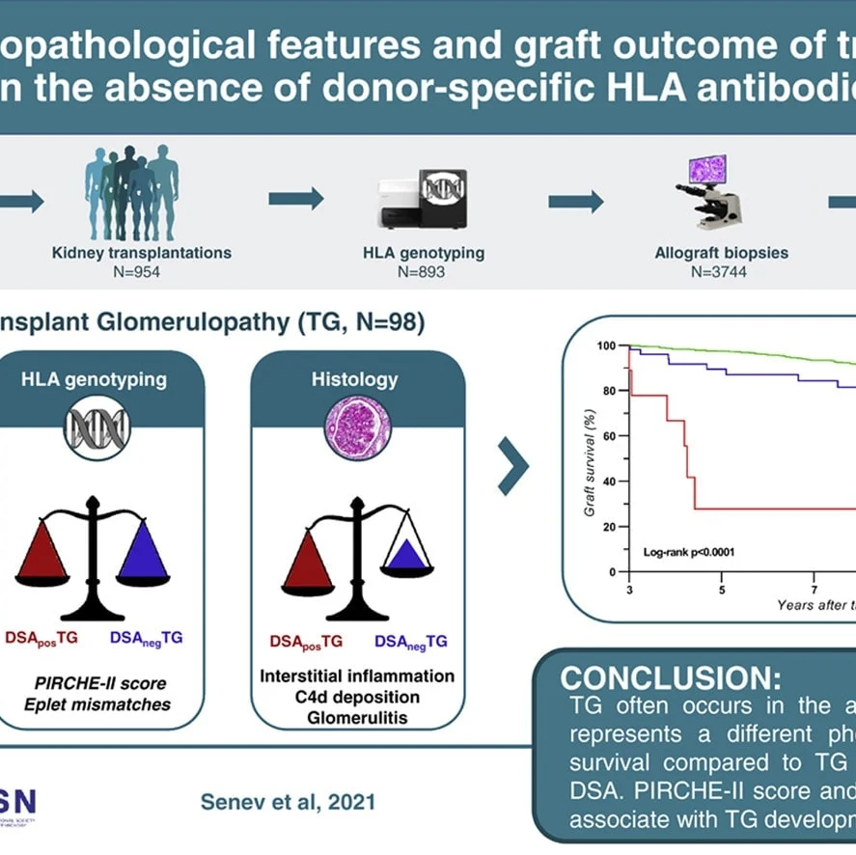
RadiologyAI Pro
AI-Powered Medical Imaging & Smart Hospital Finder
"Democratizing healthcare access in Gulbarga through AI-powered tools that bridge the gap between patients and quality medical care."
Contact: RadiologyAI Pro
Powered by Google Gemini AI

Slide 18

THANK YOU

